Slide 1
Using Packit and Testing Farm for CI/CD and automation in an upstream project
or “Packit appreciation talk”
Vojtech Trefny
SSE @ Red Hat

Slide 2
Who are we
We are a team working on various storage libraries and tools, mostly related to the Storaged Project¹.
We are both upstream and downstream (Fedora and RHEL) maintainers.
We are using CI/CD and automation where possible.
We are not Packit developers, just very happy users.
1) https://storaged.org

Slide 3
How we use Packit
We are using Packit for both manual and automated testing in our upstream projects and for downstream package maintenance automation.
This includes daily builds in Copr, various CI jobs on GitHub and downstream automation in Fedora dist-git.
Packit greatly simplifies cross project collaboration with our users like Cockpit and Anaconda.
1) https://storaged.org

Slide 4
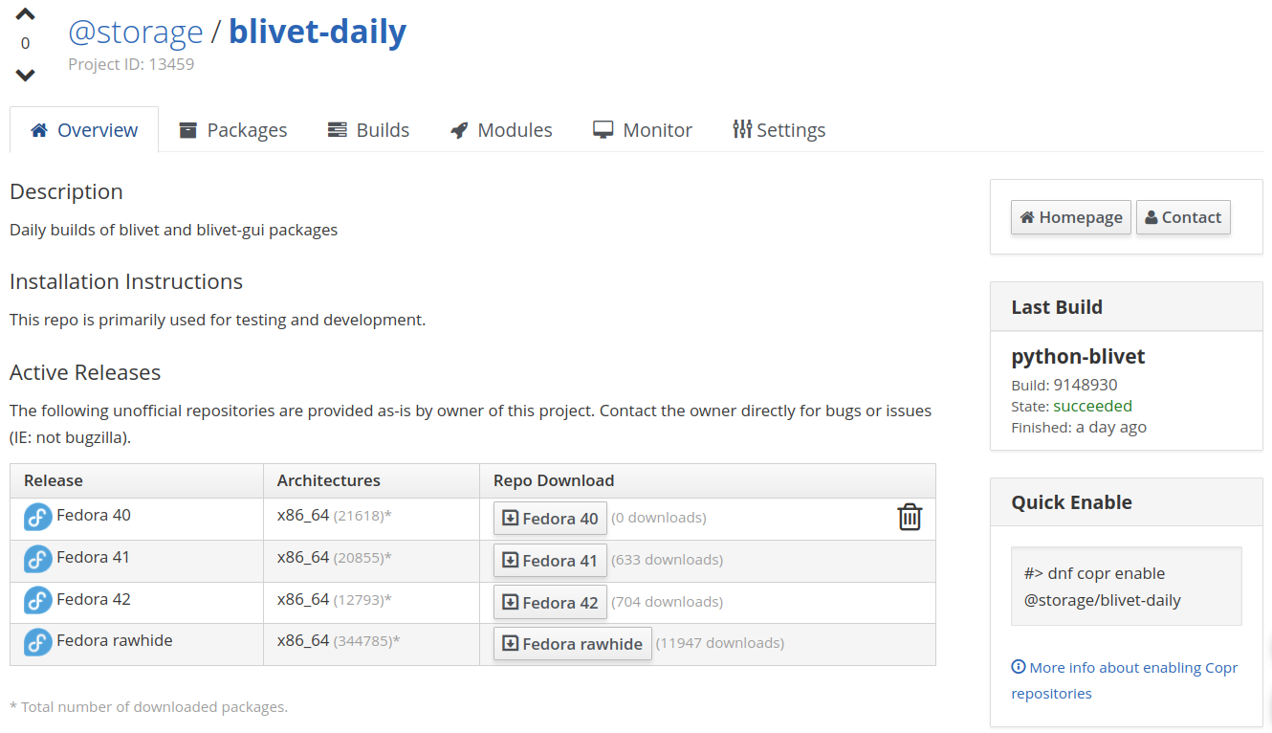
Daily builds in Copr
“Daily” Copr builds triggered by commits merged in the upstream Git.
RPM spec file available in the upstream repository.
Used for testing and development both by us and our friends for further testing.
- job: copr_build
trigger: commit
owner: "@storage"
project: blivet-daily
branch: main
preserve_project: true

Slide 5
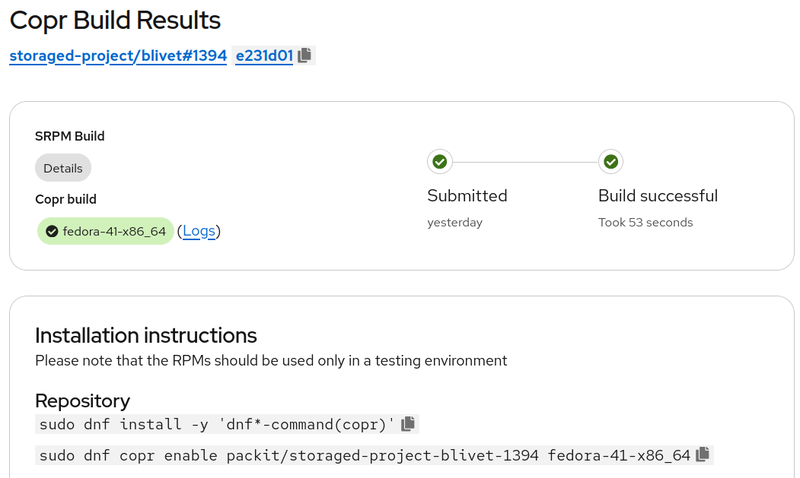
Copr builds for Pull Requests
RPM builds triggered by pull request.
Temporary Copr repositories are created automatically.
Used as a simple test case and for manual testing and for related projects.
- job: tests
trigger: pull_request
targets:
- fedora-latest
branch: main

Slide 6
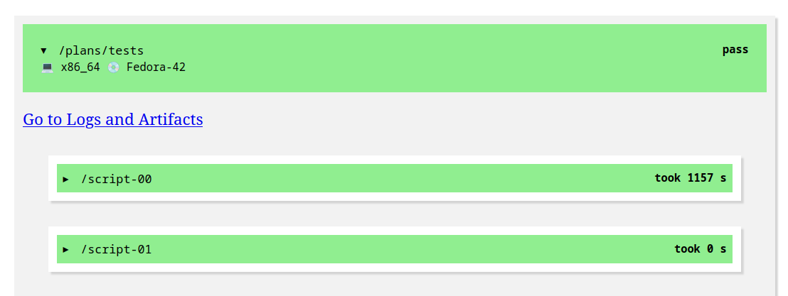
Running tests
Tests run on pull requests using Testing Farm¹.
Test plans are part of the upstream GitHub repositories.
Plans are standard Testing Farm test plans and can be also started manually with tmt.
- job: tests
trigger: pull_request
targets:
- fedora-latest
branch: main
1) https://docs.fedoraproject.org/en-US/ci/testing-farm/

Slide 7
Reverse-dependency tests
- job: tests
identifier: revdeps
trigger: pull_request
branch: main
notifications:
failure_comment:
message: "Blivet-GUI tests failed for commit {commit_sha}. @vojtechtrefny please check."
targets:
- fedora-latest
tf_extra_params:
environments:
- artifacts:
- type: repository-file
id: https://copr.…
tmt:
context:
revdeps: "yes"
Running test suites of users of our APIs on pull requests.
Ensures we don’t break projects depending on us.
Our projects and Cockpit¹ are currently covered.
1) https://cockpit-project.org/blog/tmt-cross-project-testing.html

Slide 8
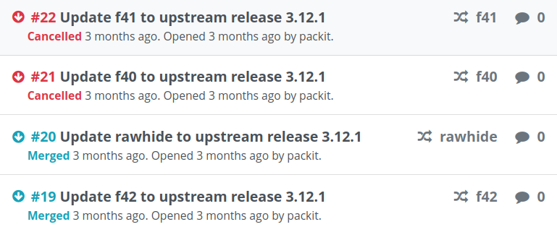
Downstream builds automation
Triggered by upstream release (git tag).
Packit opens Pagure PRs against all Fedora branches.
Koji build is triggered after merging the PR.
Bodhi updates are created automatically for branched Fedora versions.
- job: propose_downstream
trigger: release
dist_git_branches:
- fedora-all
- job: koji_build
trigger: commit
dist_git_branches:
- fedora-all
- job: bodhi_update
trigger: commit
dist_git_branches:
- fedora-branched

Slide 9

Not only Fedora
Other distributions supported by Copr and Testing Farm can be used as well.
We have Copr builds and tests set up to help with backporting patches for RHEL/CentOS Stream.
Support for building openSUSE packages in OBS was added recently¹.
- job: copr_build
targets:
- centos-stream-10-x86_64
trigger: pull_request
branch: rhel10-branch
- job: tests
trigger: pull_request
targets:
- centos-stream-10-x86_64
branch: rhel10-branch
1) https://pretalx.devconf.info/devconf-cz-2025/talk/7DESJP/

Slide 10
...and more
$ packit scan-in-osh
...
Directory with sources: /home/vtrefny/Projekty/blivet
...
Full command passed to osh-cli -> ['osh-cli', 'mock-build', '/home/vtrefny/Projekty/blivet/python-blivet-3.12.1-1.20250611131534246573.main.67.g53f74344.fc42.src.rpm', '--config=fedora-rawhide-x86_64', '--nowait', '--json', '--comment=Submitted through Packit.']
Scan URL: http://openscanhub.fedoraproject.org/task/59518/
Packit CLI¹
  Need RPMs for manual testing? Simply run
  $ packit build locally
OpenScan Hub² integration
  Runs OSH check for every PR
  Can be triggered manually with
  $ packit scan-in-osh
1) https://packit.dev/docs/cli
2) https://openscanhub.dev/

Slide 11
Packit is great!
Packit is great for both upstream and downstream and you should use it too.
Copr builds, both daily and on PR, are very useful for developers working in Fedora and RHEL ecosystem.
Integration with Testing Farm is great for CI, especially for test cases that cannot run in a container.
Dist-git automation saves a lot of time.

Slide 12
Thank you for your attention
Packit resources
  https://packit.dev/
  https://dashboard.packit.dev/
Storaged Project
  https://storaged.org/
  https://github.com/storaged-project
Contact:
  vtrefny@redhat.com

